Slide 1
Notes:
This slide is for use only by production crew. Speakers must not include this slide in their presentation. The first slide for speakers must be the title slide that displays the session title, speaker name, and session code.

Slide 2
JavaScript from Client to Cloud
Nathan Totten
Technical Evangelist
3-041

Slide 3
Assumptions
You are familiar with:
JavaScript
Windows Store Apps
You may have used:
Windows Azure
Node.js

Slide 4
What will we cover?
Quick Review of Windows Store Apps and Web Apps
Node.js
Connect it all together
Q/A (if we have time)

Slide 5
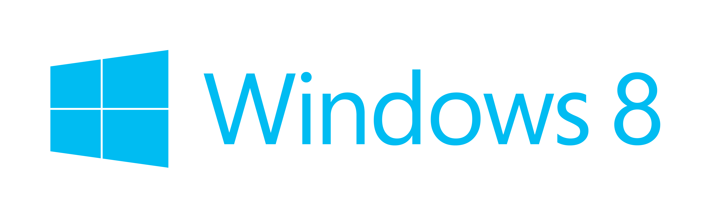
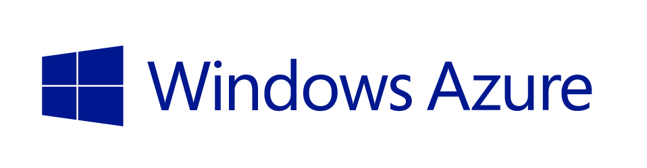

JavaScript Platforms

Slide 6
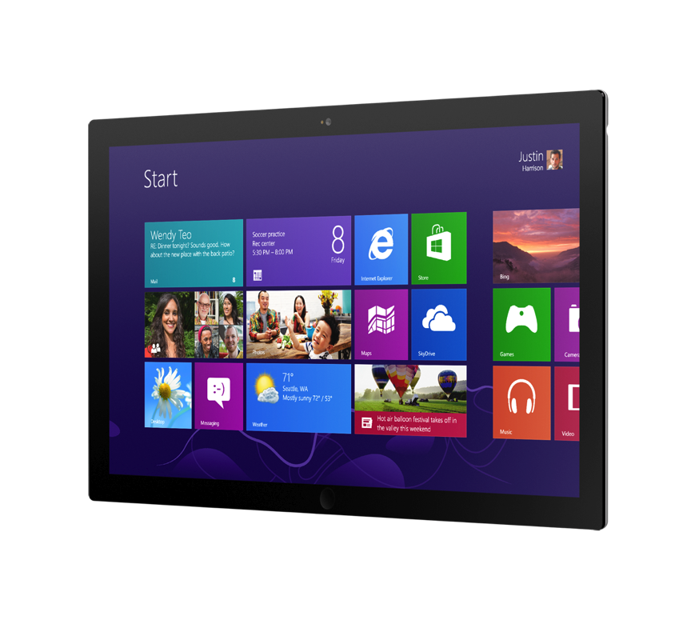
Familiar Language
Full Windows Runtime
Hardware Acceleration
Multitouch

Slide 7

Modern Browsers
Multiplatform
Any Form Factor
Hardware Acceleration (partial)

Slide 8

JavaScript on the Server
Not thread based
Efficient and highly scalable

Slide 9
Async Model
Single-threaded event loop
Run DB query
Work queue
The one-and-only thread
New request
New request
DB query results
DB query results
Poll timeout

Slide 10
Node is…
Excellent for:
OK for:
Realtime comms
Sockets, polling, etc.
Custom network services
Media servers, proxies, etc.
JSON web services
Thin app layer on top of a datastore
Client-oriented web UIs
Anything you’d build with Sinatra
“Forms over data” CRUD apps
Rails/ASP.NET give you more
Wrong for:
Doing CPU intensive processing
Video transcoding, etc.
Though it could proxy to a transcoder

Slide 11
IIS Node
Process management
Scalability on multi-core servers
Access to logs over HTTP
Side by side with other content types
Integrated management experience
WebSockets on Windows Server 2012
Notes:
See: http://tomasz.janczuk.org/2011/08/hosting-nodejs-applications-in-iis-on.html

Slide 12
IIS Node
<configuration>
<system.webServer>
<handlers>
<add name="iisnode"
path="server.js"
verb="*"
modules="iisnode" />
</handlers>
</system.webServer>
</configuration>
IIS
iisnode (native module)
Node.exe
Node.exe
Node.exe
Node.exe
Notes:
IISNode
– load balances across the Node.exe instances
- Auto-restarts when app.js changes
- captures console output and logs it to disk
- lets you host traditional ASP.NET code in the same IIS app (it’s just another handler)

Slide 13



Windows Azure
flexible
open
solid

Slide 14
Global Footprint

Slide 15









Windows Azure for Node Apps
store
database
storage
caching
messaging
CDN
cloud services
web sites

Slide 16
//demo/

